Slide 1
Use -cases

Slide 2
“A Use Case specifies the behavior of a system or a part of a system and is a description of a set of sequences of actions.”
“Use case diagrams are usually referred to as behavior diagrams used to describe a set of actions (use cases) that some system or systems (subject) should or can perform in collaboration with one or more external users of the system (actors).”

Slide 3
“A use case diagram is a graphic depiction of the interactions among the elements of a system Use case diagrams are employed in UML (Unified Modeling Language), a standard notation for the modeling of real-world objects and systems.”

Slide 4
Term and Concept
Use Case
Every Use Case must have a name that distinguishes it from other use cases.
The name alone is known as a simple name.
A path name is the Use Case name prefixed by the name of the package in which that Use Case lives.

Slide 5
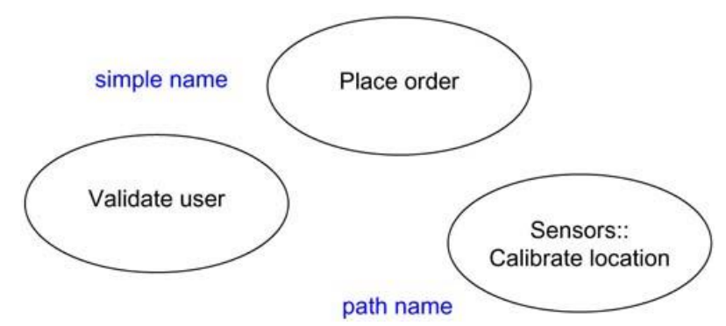
Simple and Path Names

Slide 6
Actors
An actor has a single well-defined purpose.
An actor represents a coherent set of roles that users of Use Cases play when interacting with these Use Cases.
There can be generalization-specialization relationship among actors as well.
For e.g., there can be general actor like Customer and a specialized actor called CommercialCustomer.
Actors may be connected to Use Cases only by association.

Slide 7
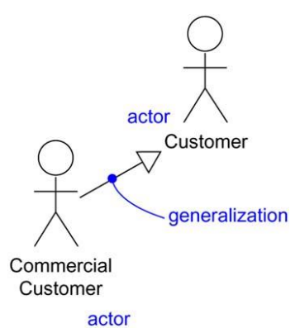
Actors

Slide 8
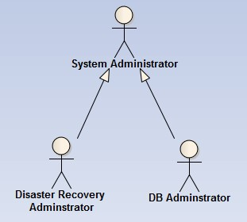
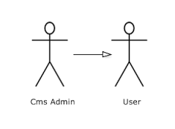
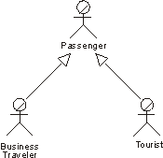
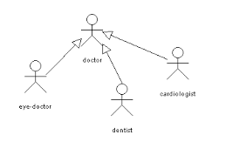

Slide 9
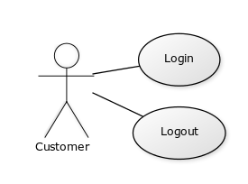
Example

Slide 10
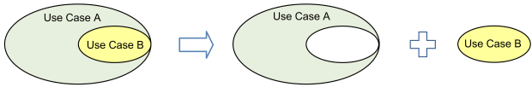

Organizing Use Cases
The include relationship could be used: to simplify large use case by splitting it into several use cases, to extract common parts of the behaviors of two or more use cases.
Extending use case typically defines optional behavior that is not necessarily meaningful by itself.

Slide 11
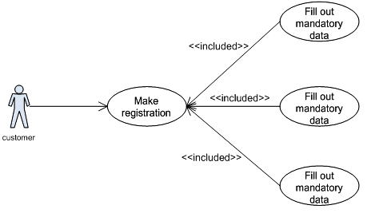
Include

Slide 12
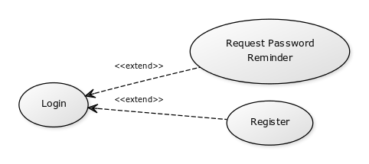
Extend

Slide 13
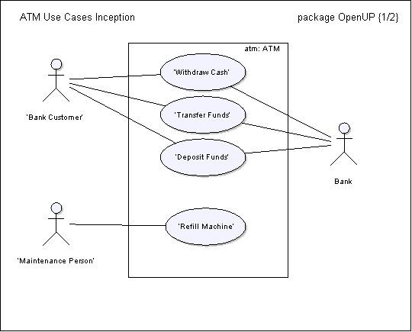

Slide 14
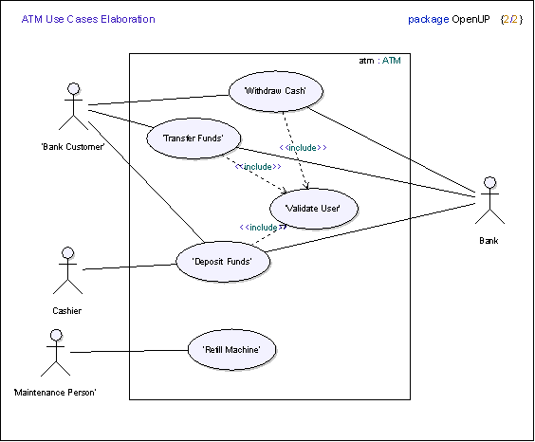

Slide 15
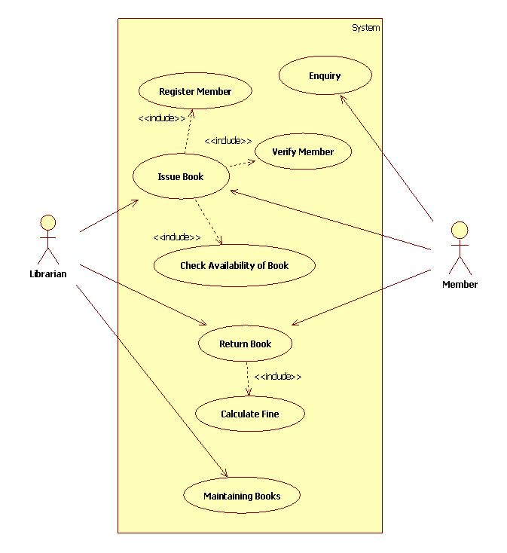

Slide 16
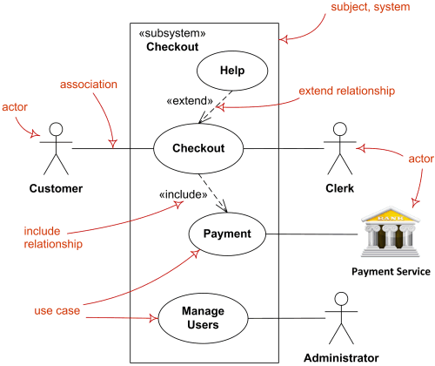

Slide 17
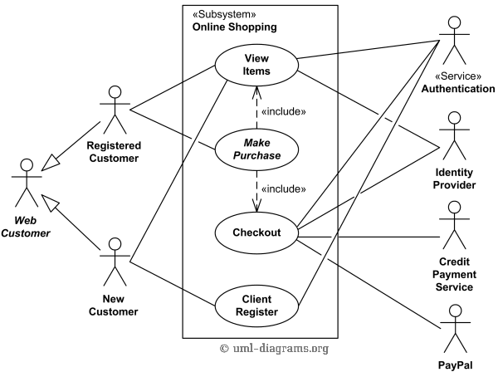

Slide 18
